Slide 1
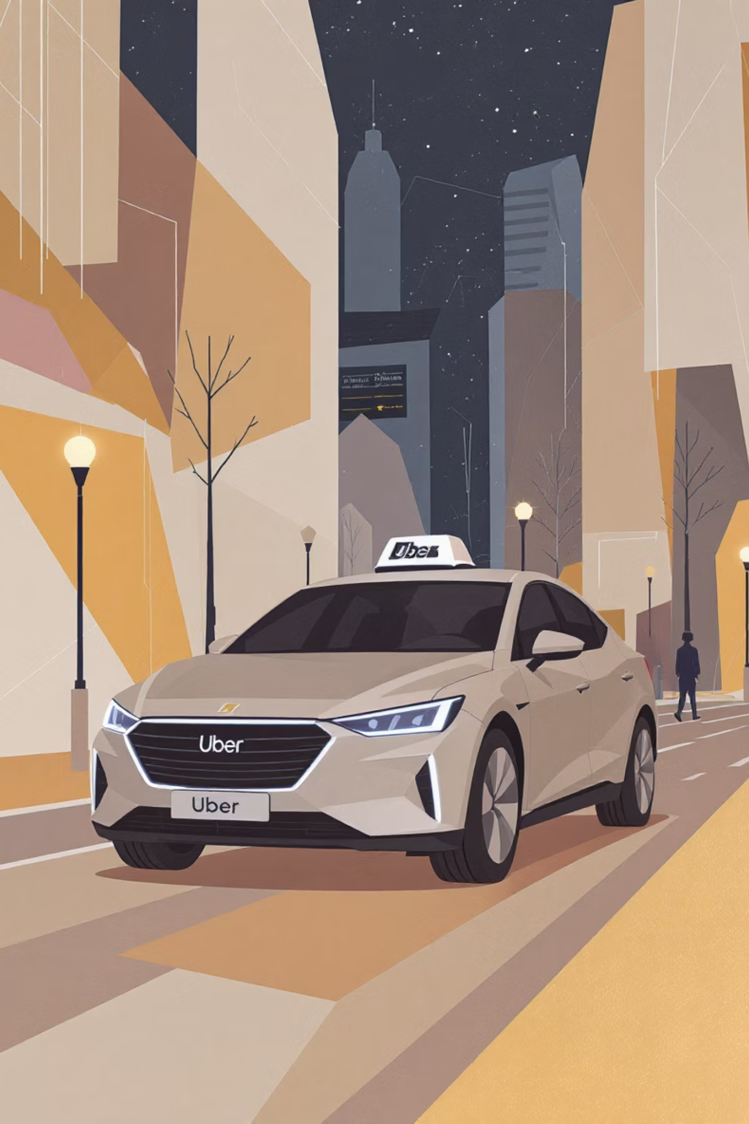
Uber Ride Booking Data Analysis
Uncovering patterns in customer behavior, driver performance, and operational efficiency through 150,000 ride records.

Slide 2
Dataset Overview
150K
18
7
Total Records
Data Columns
Vehicle Types
Comprehensive ride data analyzed
Key features tracked
Sedan, Mini, Auto, and more
Booking Details
Trip Metrics
Booking ID, Date, Time
Pickup and Drop Locations
Status and Value
Ride Distance and Duration
Payment Method
Customer and Driver Ratings

Slide 3
Data Preparation Process
01
02
Data Loading
Column Standardization
Imported dataset using pandas and performed initial exploration with df.info() and .describe()
Renamed columns to snake case for better readability and documentation
03
04
Missing Data Handling
Database Integration
Replaced null values with "Not Applicable" for successful rides while maintaining data integrity
Connected Python to MySQL and loaded cleaned DataFrame for SQL analysis

Slide 4

Revenue Analysis
Revenue by Vehicle Type
Payment Method Breakdown
Auto vehicles lead overall bookings at ₹12M, followed closely by Go Mini at ₹9M, highlighting the dominance of compact and affordable cab types in customer demand.
UPI is the most preferred payment method with ₹21M in revenue, followed by Cash at ₹12M, highlighting the growing adoption of digital transactions among customers.

Slide 5
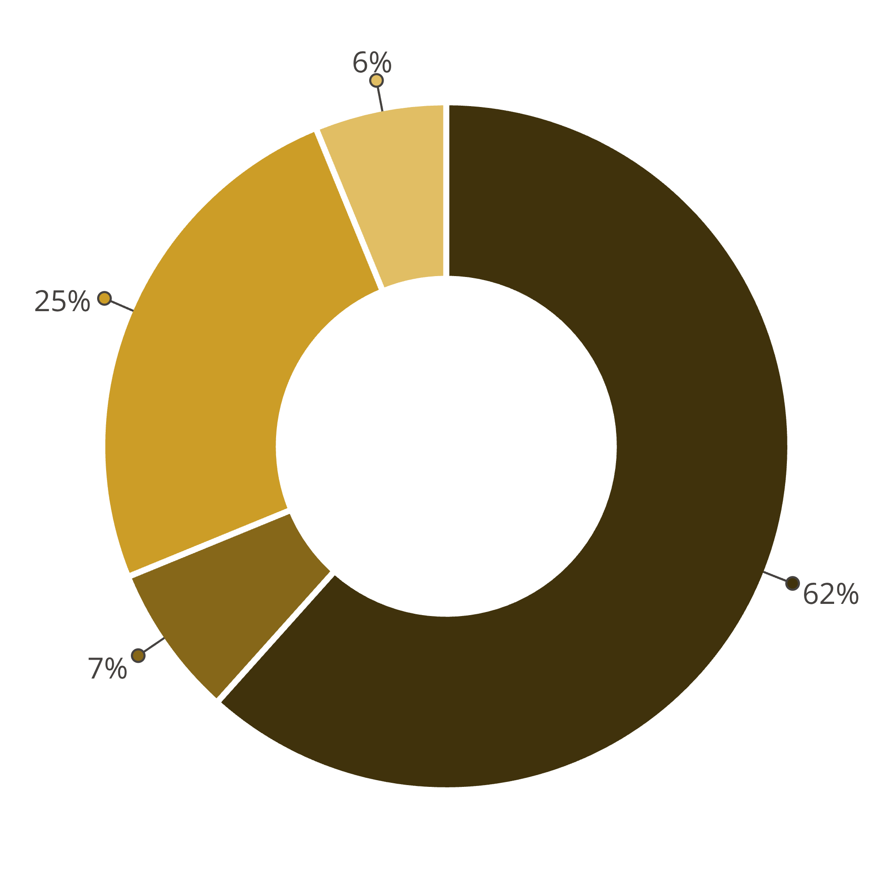
Booking Status Distribution
Completed
Cancelled by Customer
Driver-Related Cancellations
Incomplete
Overall service efficiency shows room for improvement in reducing cancellation rates from both customers and drivers.

Slide 6

Peak Demand Patterns
Morning
Evening
Moderate demand during commute hours
Second peak during return commute
1
2
3
4
Afternoon
Night
Peak booking period with highest revenue
Lower demand with reduced bookings
Top 5 Pickup Locations
Top-Spending Customers
Khandsa, Barakhamba Road, Pataudi Chowk, Subhash Chowk, and Tughlakabad emerge as the busiest pickup zones, enabling data-driven driver allocation and reduced passenger wait times.
High-value customers highlighted for loyalty and retention strategies.
Subhash Chowk
Barakhamba Rd
Khandsa
Pataudi Chowk
Tughlakabad

Slide 7

Driver Performance Insights
Excellent Drivers
4.5+ rating with consistent completed rides
Good Drivers
4.0-4.5 rating with reliable service
Average Drivers
3.5-4.0 rating needing improvement
Poor Drivers
Below 3.5 rating requiring intervention

Slide 8

Cancellation Analysis
Driver Cancellation Reasons
Customer Cancellation Reasons
Customer not responding
Driver taking too long
Wrong pickup location
Found alternative transport
Long wait time
Changed plans
Technical issues
Incorrect booking details
Understanding cancellation patterns helps identify service gaps and improve overall ride experience.

Slide 9
Power BI Dashboard Highlights
Overall Insights
Revenue & Fare Analysis
Customer Insights
Driver Insights
Comprehensive view of booking trends and operational metrics
Behavior patterns, ratings, and cancellation trends
Performance categorization and cancellation analysis
Payment methods and vehicle type profitability breakdown

Slide 10
Business Recommendations
Boost Peak Hour Supply
1
Increase driver availability during afternoon and evening when demand and revenue are highest
Grow Customer Base
2
Implement loyalty rewards for existing users and retention-focused offers for new riders
Incentivize Top Drivers
3
Provide recognition, bonuses, or badges to high-rated drivers to maintain service quality
Reduce Cancellations
4
Improve ride allocation algorithms to minimize last-minute cancellations from both sides
Plan Seasonal Trends
5
Use monthly revenue insights to target marketing and resource allocation strategically

